Slide 1
Notes:
This is a Hero Slide without Picture.

Slide 2
Cloud, DevOps and IaC
Erno Venäläinen
Cloud Architect
Oracle Finland
Notes:
This is a Title Slide without Picture.

Slide 3
What is DevOps?
An (emerging) professional movement that advocates a collaborative working relationship between Development and IT Operations, resulting in the fast flow of planned work (high deploy rates) while simultaneously increasing the reliability, stability, resilience and security of the production environment.
3

Slide 4
What is DevOps?
4

Slide 5
What is DevOps?
Shift from CI pipelines to DevOps assembly lines
5

Slide 6
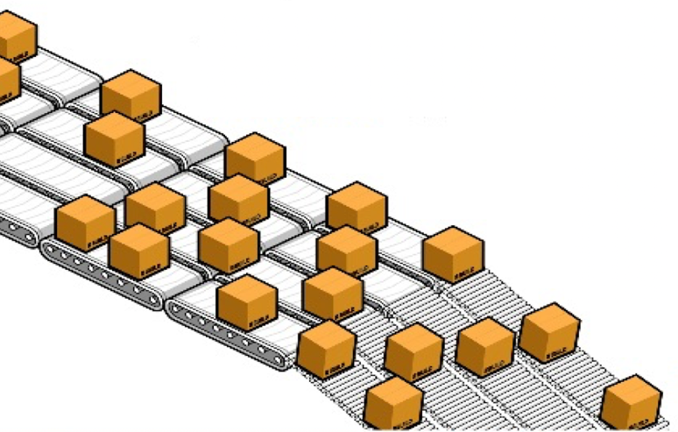
What is DevOps?
De-risk software delivery by decreasing batch size
6

Slide 7
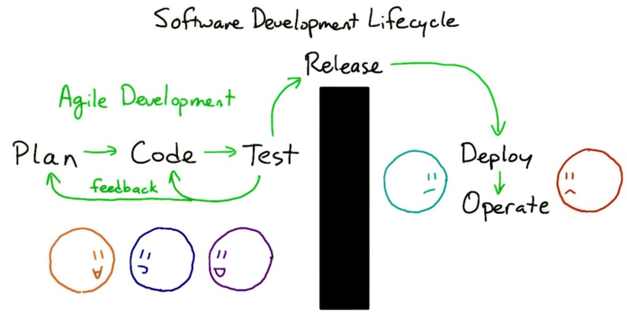
What is DevOps?
Shift left mentality
7

Slide 8
What is DevOps?
Emphasis on communication and Systems Thinking
8

Slide 9
Value Stream Mapping
A lean-management method for analyzing the current state and designing a future state for the series of events that take a product or service from its beginning through to the customer with reduced lean wastes as compared to current map.
9

